Slide 1
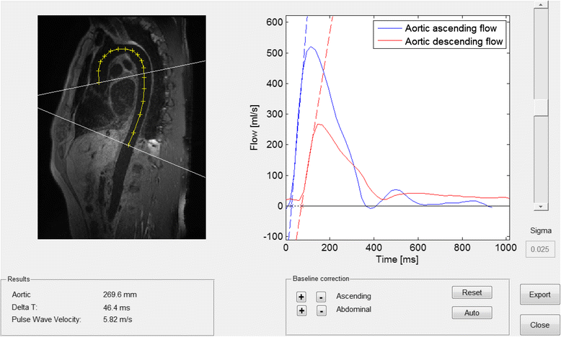
Fig. 1
From: Required temporal resolution for accurate thoracic aortic pulse wave velocity measurements by phase-contrast magnetic resonance imaging and comparison with clinical standard applanation tonometry
The graphical user interface for pulse wave velocity assessment. The oblique sagittal image of the aorta (left) shows the perpendicular flow measurement planes (white lines) in the ascending aorta and at the level of the diaphragm. The centre-line aortic distance between flow planes are shown as a yellow line with cross marks. The graph (right) shows the flow curves and respective upslope tangents with their baseline intersection points giving the time delay between flow curves (∆t; dashed part of the baseline tangent)
Dorniak 2018

Slide 2
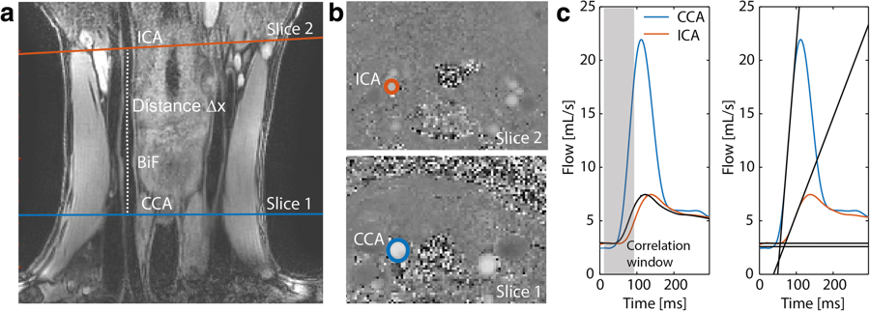
Fig. 2
From: Regional assessment of carotid artery pulse wave velocity using compressed sensing accelerated high temporal resolution 2D CINE phase contrast cardiovascular magnetic resonance
PWV calculation using 2D CINE PC CMR and black-blood CMR. a Black-blood image and curved path ∆x tracked between the two slices. b Velocity images acquired perpendicular to the common carotid artery (slice 1) and the internal carotid artery (slice 2). c The transit time was calculated from the two flow curves using the CC (left) and FF (right) method. Details on the CC and FF methods are shown in Additional file 1: Figure S1. CCA=common carotid artery; ICA=internal carotid artery
Peper 2018

Slide 3
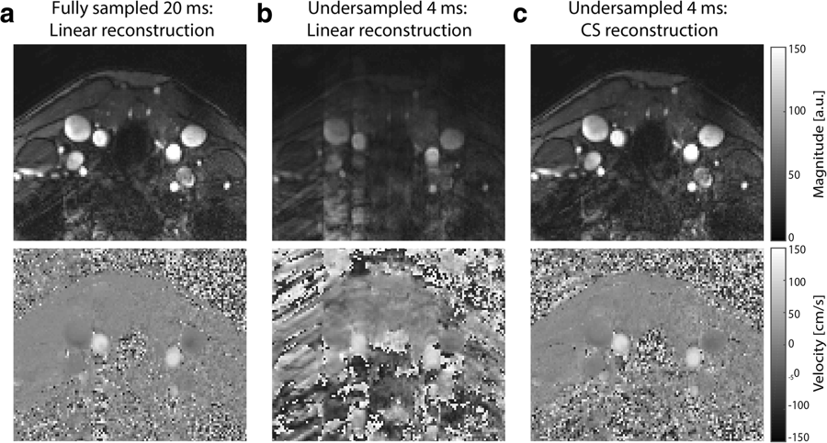
Fig. 5
From: Regional assessment of carotid artery pulse wave velocity using compressed sensing accelerated high temporal resolution 2D CINE phase contrast cardiovascular magnetic resonance
Linear and CS reconstructions of magnitude and velocity images. a Magnitude and velocity images from a fully sampled in vivo dataset of 20 ms temporal resolution. The same dataset reconstructed at a temporal resolution of 4 ms using (b) a linear reconstruction and (c) a compressed sensing (CS) reconstruction
Peper 2018

Slide 4
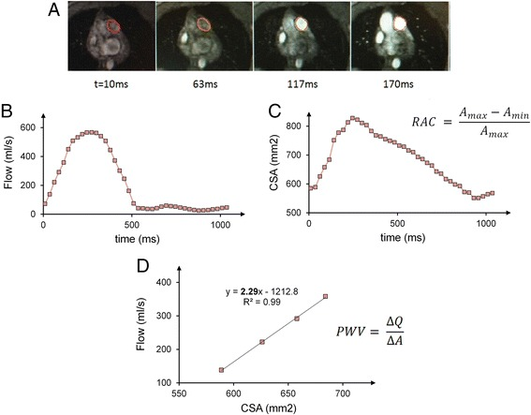
RAC measurement and PWV measurement with flow-area method for a representative subject. a Time-lapse of magnitude and phase images of main PA cross-section during early systole. b and c Flow rates and cross-sectional area (CSA) of the main PA were assessed based on the contours shown in the images. RAC is measured using maximum and minimum CSA throughout the cardiac cycle d Flow and CSA are measured from the phase contrast-derived velocity maps integrated over the magnitude-derived area. PWV velocity is calculated as the slope of QA plot at early systole
Forouzan 2015

Slide 5
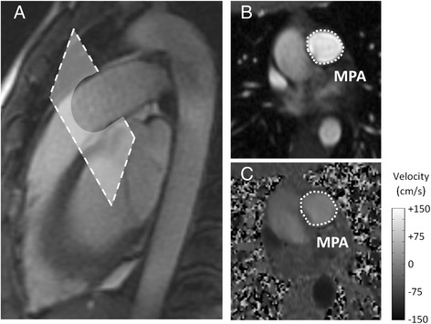
MR images of main PA for a representative subject. a Sagittal image of the MPA displaying the location of 2D-PC acquisition slice. The imaging plane is prescribed in a double-oblique plane perpendicular to the flow direction. b 2D-PC magnitude image of the main PA, used to define and measure the cross-sectional area. c 2D-PC phase image, used to calculate the blood flow velocity, of the MPA. Grayscale-bar represents flow velocity in the phase image (ranges from -150 cm/s to 150 cm/s)
Forouzan 2015

Slide 6
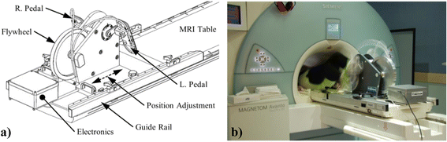
From: Real-time aortic pulse wave velocity measurement during exercise stress testing
Custom-built CMR compatible ergometer. a Schematic showing adjustable position to accommodate different body sizes. b Volunteer cycling in the scan position
Roberts 2015 JCMR

Slide 7
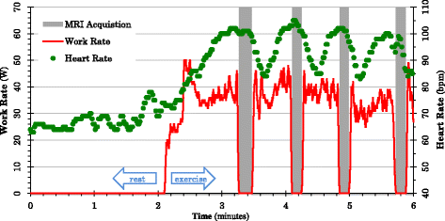
From: Real-time aortic pulse wave velocity measurement during exercise stress testing
Work rate (red) and heart rate (green) during the rest and exercise phases of the protocol. Grey bands indicate breath-hold acquisitions when cycling is ceased
Roberts 2015 JCMR

Slide 8
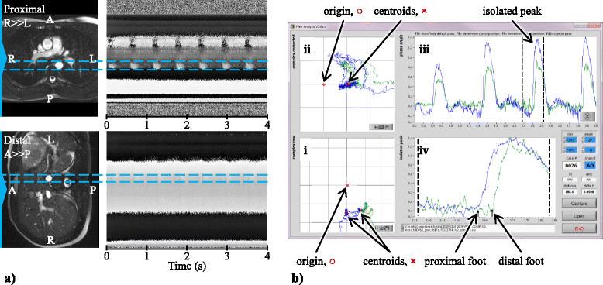
From: Real-time aortic pulse wave velocity measurement during exercise stress testing
MRI PWV analysis. a Region of interest selection guided by anatomical images (left) and corresponding RACE phase image (right). bCorrection for stationary tissue signal in the complex domain, with proximal (superior) slice signal in the vessel region shown in blueand distal (inferior) signal in green. b-i Raw data plotted in the complex plane, showing centroids marking slow flow signal. b-iiComplex signal relative to the reference static tissue point. b-iii Phase waveforms relative to the reference point. b-iv Estimation of foot transit time
Roberts 2015 JCMR

Slide 9
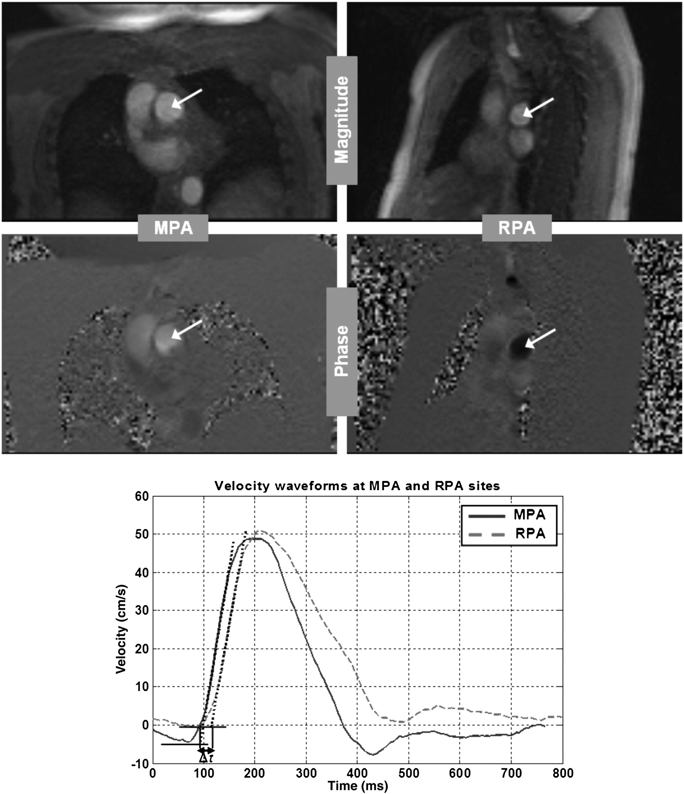
Ibrahim 2011

Slide 10
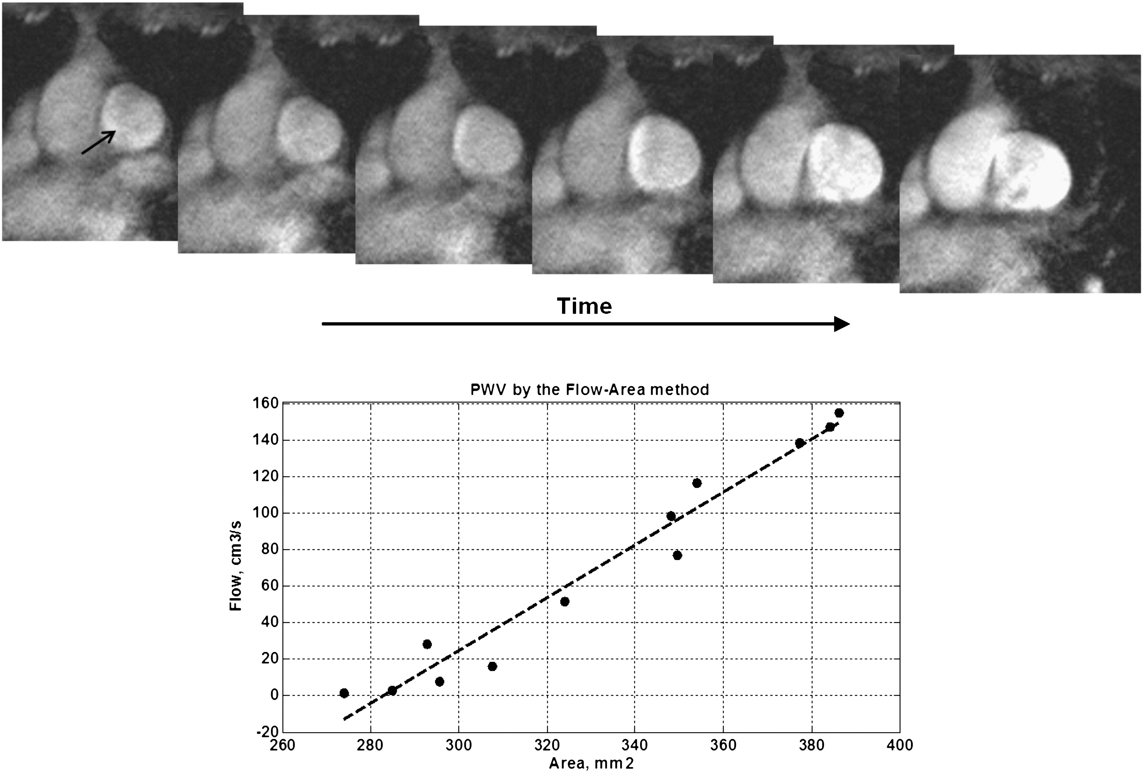
Ibrahim 2011

Slide 11
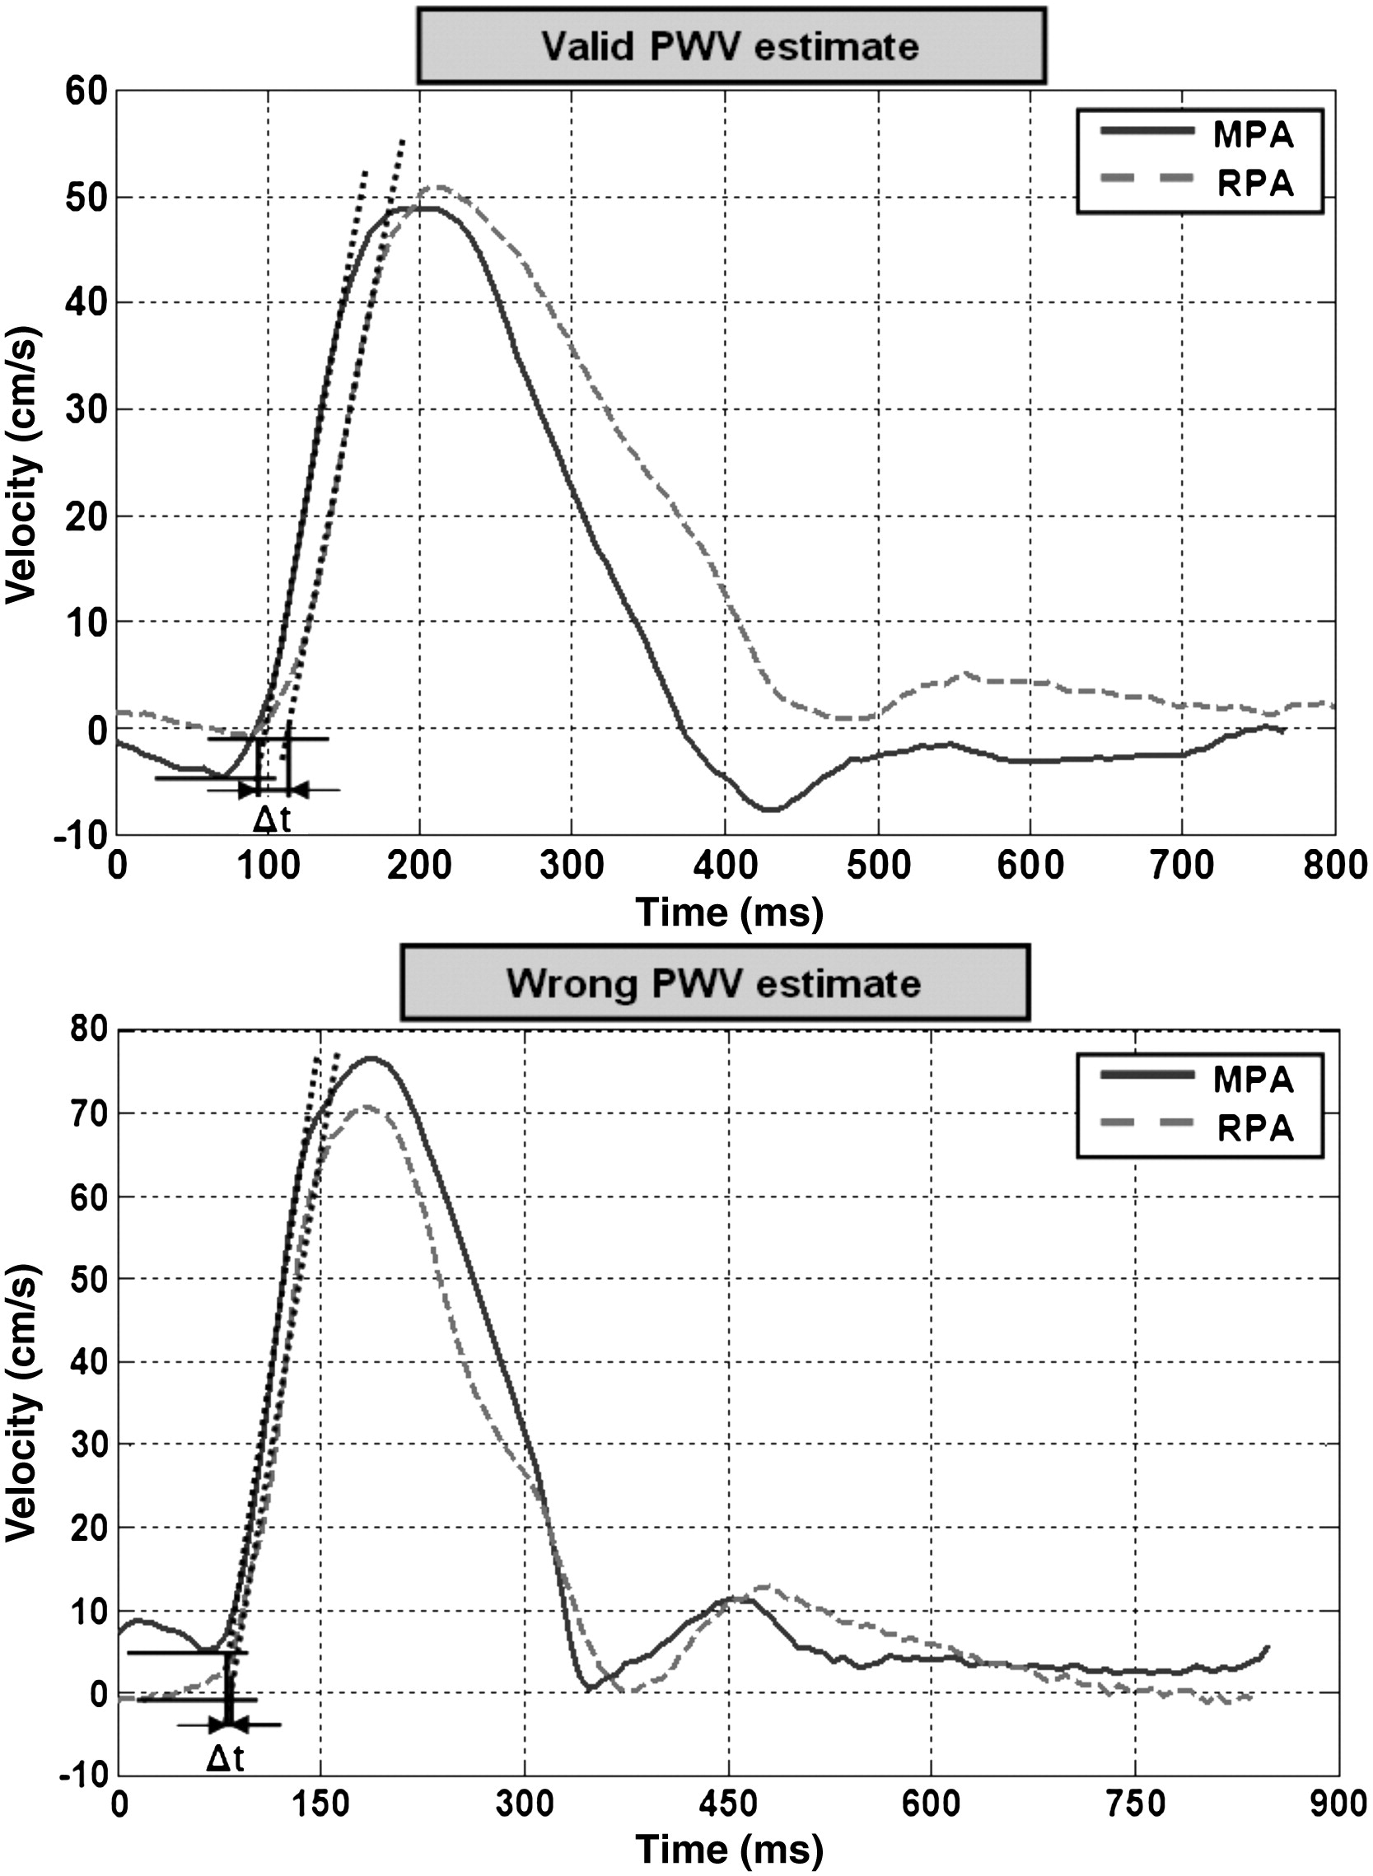
Ibrahim 2011

Slide 12
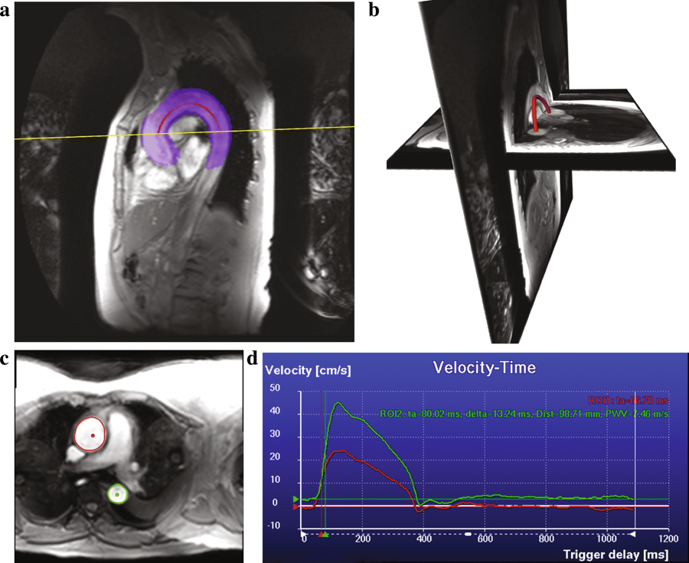
From: Quantification of aortic pulse wave velocity from a population based cohort: a fully automatic method
The resulting segmentation of the aorta for one of the subjects after multi-atlas-based segmentation (in blue) and the calculated centerline (in red) on the multi-slice scan (a). The multi-slice scan and the VE scan with the extracted centerline represented in 3D (b). Automatically delineated ascending and descending aorta contours on the magnitude VE scan, the two dots indicate the centerline point that were used as initiation (c). The computed flow curves obtained from the phase VE scan (d), red curve is the velocity-time curve for the ascending aorta (ROI1) and the green curve is the velocity-time curve for the descending aorta (ROI2), ta stands for arrival time, delta stands for transit time, Dist is the length of the aortic arch and PWV is the pulse wave velocity
Shazad 2019

Slide 13
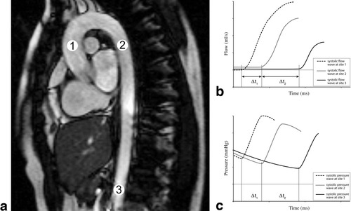
Validation and reproducibility of aortic pulse wave velocity as assessed with velocity‐encoded MRI
Groitenhus 2009
Journal of Magnetic Resonance Imaging, Volume: 30, Issue: 3, Pages: 521-526, First published: 26 August 2009, DOI: (10.1002/jmri.21886)

Slide 14
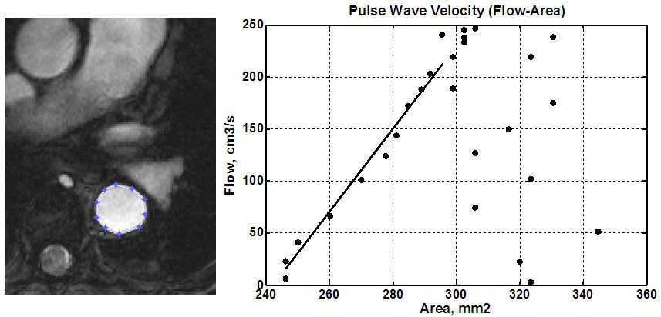
From: Measuring aortic pulse wave velocity using high-field cardiovascular magnetic resonance: comparison of techniques
Flow-area method. PWV results from a volunteer scan. A cross section of the aorta is shown (left), where the user marks the aorta boundary. The panel on the right shows the change in aortic cross sectional area versus total flow at different frames in the cardiac cycle. A line is fitted to the data during the initial slope of the curve at early systole, from which PWV is calculated. After systole, ROIs were drawn large to separate them from earlier points and avoid confounding the linear fit.
Ibrahim 2010

Slide 15
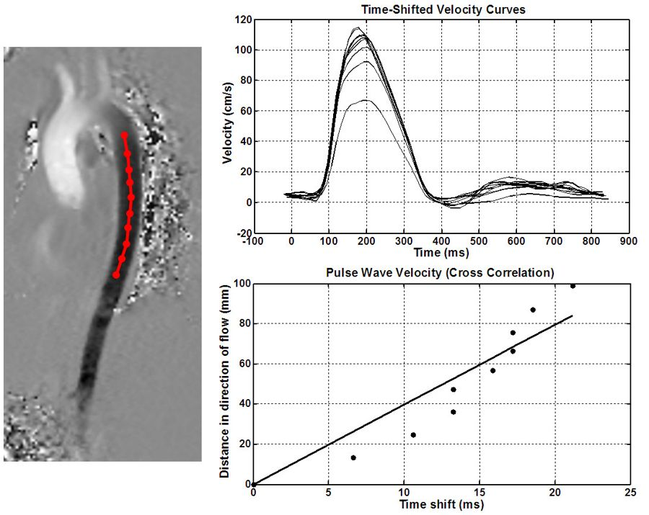
From: Measuring aortic pulse wave velocity using high-field cardiovascular magnetic resonance: comparison of techniques
Cross-correlation method. Flow patterns (up) from a volunteer scan are computed at several points along the descending aortic path (left). Cross correlation is used to estimate the time shift between consecutive points. Linear least-square fitting is used to calculate PWV (down).
Ibrahim 2010

Slide 16
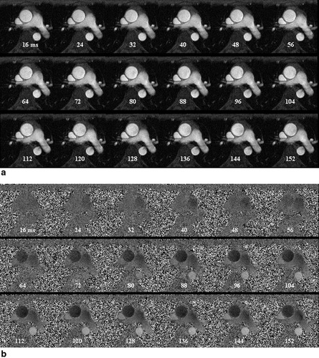
Estimation of local aortic elastic properties with MRI
Vulliémoz 2002
Magnetic Resonance in Medicine, Volume: 47, Issue: 4, Pages: 649-654, First published: 28 March 2002, DOI: (10.1002/mrm.10100)

Slide 17
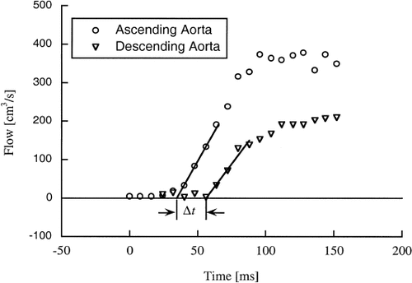
Estimation of local aortic elastic properties with MRI
Vulliémoz 2002
Magnetic Resonance in Medicine, Volume: 47, Issue: 4, Pages: 649-654, First published: 28 March 2002, DOI: (10.1002/mrm.10100)

Slide 18
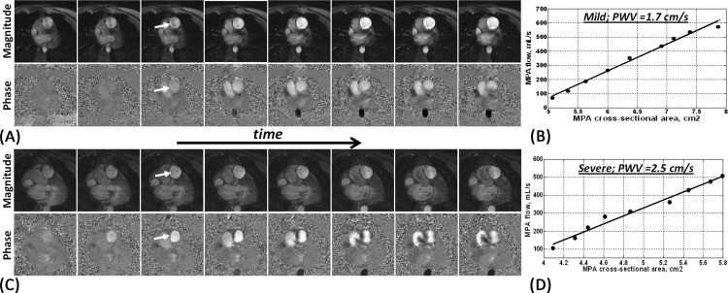
Pulmonary artery (PA) distensibility and pulse wave velocity (PWV), as measured using the flow-area method applied on velocity-encoded MRIs. (A) Successive frames of magnitude (top) and the corresponding phase (bottom) images showing early-systolic blood flow in the PA (arrow) in a patient with mild pulmonary arterial hypertension (PAH). Noticeable increases in the PA cross-sectional area and blood flow are observed. (B) PWV is calculated from the images in (A) as the ratio of change in blood flow to change in PA area. Images shown in (C) and (D) are similar to (A) and (B) in a patient with severe PAH (slight change in PA cross-sectional area, which results in a large PWV).
Ibrahim 2015

Slide 19
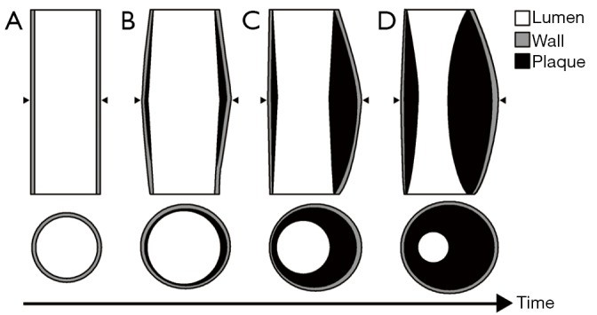
Glagov phenomenon showing plaque development over time in vessel cross-sections and along the length of the vessel. Compared to a normal vessel (A), early plaque development (B) causes outward remodeling of the vessel wall, which leads to either no change in vessel diameter or slight dilatation. Over time the compensatory dilatation of the vessel fails and the plaque begins to encroach upon the vessel lumen (C,D). Arrow heads identify the region from where the cross-sectional depictions are taken from the length-wise view of the vessels.
Wentland 2014

Slide 20
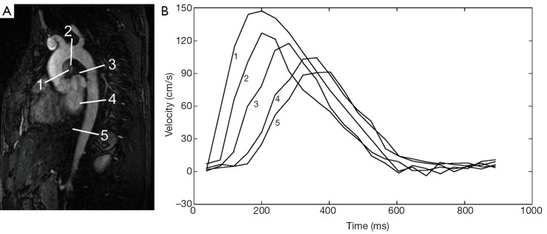
This double oblique view of the thoracic aorta from a magnetic resonance angiogram (MRA) (A) is used to show five slices from which aortic mean velocity waveforms are derived from a flow sensitive MR imaging sequence. (B) From the five velocity waveforms a temporal shift can be appreciated as the aorta is traversed. This shift can be used to compute the pulse wave velocity either regionally, for example from any two of these waveforms, or globally, using all of the waveforms. Note that maximum velocity decreases progressively at downstream slice locations; maximum velocity decreases for a number of reasons, including resistance to flow and loss of flow volume from vessels branching from the aorta. The 5 flow waveforms in (B) are derived from the 5 slices in (A).
Wentland 2014

Slide 21
Wentland 2014

Slide 22
Wentland 2014

Slide 23
Wentland 2014

